Slide 1
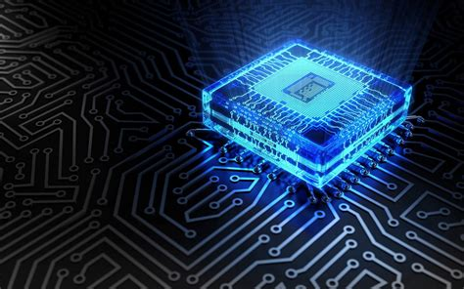
THE PROCESSOR: CPU

Slide 2

Objectives
At the end of the lesson students should be able to:
Define the term CPU architecture.
Describe what is meant by the RISC architecture.
Describe what is meant by the CISC architecture.
Compare the RISC and CISC architecture
Define the term pipelining.
Outline the process of pipelining in the CPU.
Describe register use in pipelining.
State the advantages and disadvantages of pipelining.

Slide 3
Revision
Define the Term CPU/Processor
Draw a simplified diagram to outline the architecture of the CPU with the ALU, CU and registers
State the function of the following
Control unit ALU Registers
Give examples of two types of register and their role in the fetch execute cycle

Slide 4
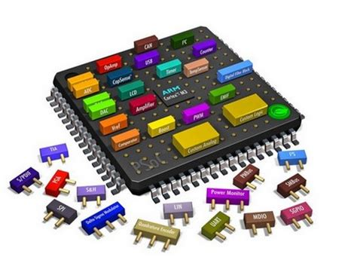
CPU Architectures
What is the CPU Architecture?
It is the internal design of the operational structure of the CPU
There are different type of computer processor and each processor (CPU) has its own set of machine code instructions that it can work with.
All of the instructions together for any particular CPU are known as the CPU’s 'instruction set’.
One type of CPU instruction set will not be able to use the same instruction set on different type of CPU.
These instruction set forms the basis for the design of the CPU or often called the CPU architecture

Slide 5
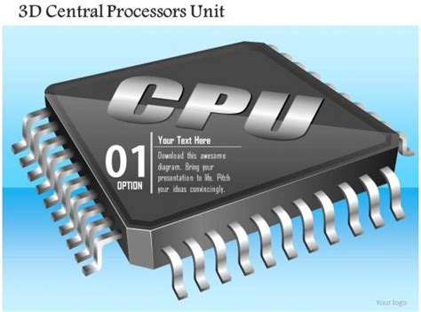
TYPES
Processor instruction set fall into 2 categories
RISC (Reduced Instruction Set Computers use a set of instructions are simple
CISC – Complex Instruction Set Computers. These allow for more complex instructions

Slide 6


RISC is a computer that uses a central processing unit (CPU) that implements the processor design principle of simplified instructions. It is the most efficient CPU architecture technology
It uses only simple instructions that can be executed within one clock cycle
It allow the LOAD/STORE operation to access memory. The rest of the operations work on a register-to-register basis.
This feature of restricting operands to registers also simplifies the control unit.

Slide 7
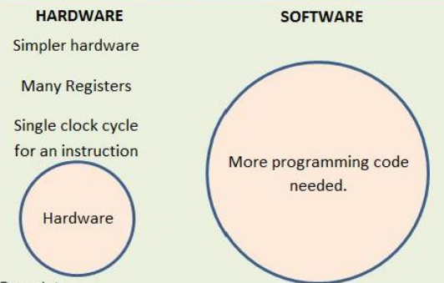
Features of the RISC
A limited number of instructions is available.
An instruction performs a simple task
Complex tasks can only be performed by combining a number of simple tasks so a task may take a number of machine cycles.
Can perform simple tasks very quickly.
Simple processor design.
Programs can run faster due to simpler instructions executing at a faster rate.
Less components on CPU
Produces less heat
Used in tablets and mobile devices

Slide 8
Examples of devices that use the RSIC processor
A limited number of instructions is available.
An instruction performs a simple task
Complex tasks can only be performed by combining a number of simple tasks so a task may take a number of machine cycles.
Can perform simple tasks very quickly.
Simple processor design.
Programs can run faster due to simpler instructions executing at a faster rate.
Less components on CPU
Produces less heat
Used in tablets and mobile devices

Slide 9
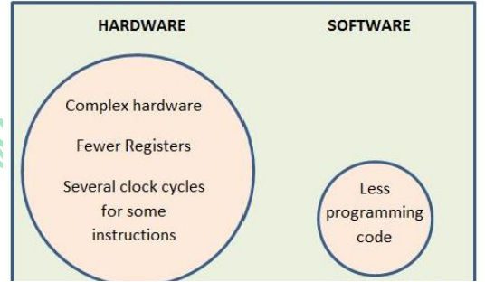
CISC Complex Instruction Set
The CISC approach attempts to minimize the number of instructions per program, sacrificing the number of cycles per instruction
Instructions uses multiple clock cycle to complete
Variable length instructions where the length often varies according to the addressing mode
A small number of general-purpose registers

Slide 10
CISC--- Complex Instruction Set
Uses complex instructions each of which may take multiple cycles.
Single register set.
Instructions have variable format.
Many instructions and addressing modes are available.
Has a complicated and expensive processor design.
Has more components on CPU than a RISC processor
Generates more heat
Requires heat sink/fan
Uses more power

Slide 11
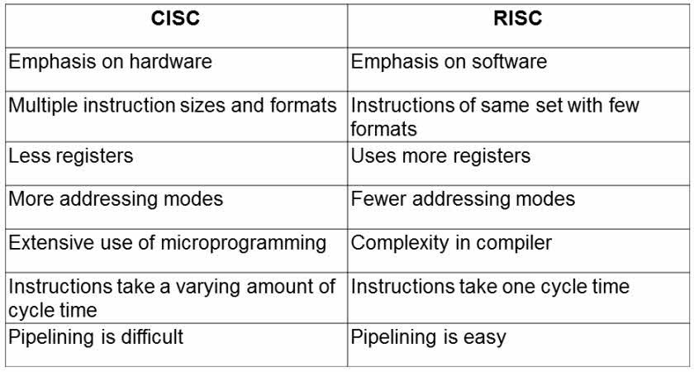
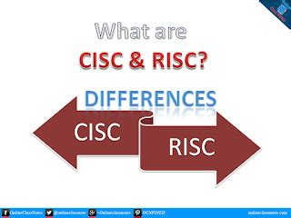

Slide 12
CISC
CISC stand for complex instruction set computer.
It has more instruction.
Transistors used for storing complex instructions.
It has variable length instruction.
It has more data types as compared to RISC.
It has multi cycle operation.
Many instruction access can memory.
It has small number of general purpose registers and several special purposes registers.
It has more addressing modes.
It has a micro programming unit.
Pipelining does not function correctly.
RISC
RISC stand for reduced instruction set computer.
It has few instructions.
Spends more transistors on memory registers.
It has fixed length instructions.
It has few data types as compared to CISC.
It has single cycle operation.
Only load/store instruction access memory.
It has large number of general purpose registers.
It has few addressing modes.
It has a hard wired unit of programming.
Pipelining does function correctly.

Slide 13
THE PROCESSOR: CPU Pipelining

Slide 14


What is Pipelining?
Pipelining is the technique of fetching an instruction whilst the prior one is being decoded and the one before that is being executed.
In modern processors the microprocess begins executing a second instructions before the first one is completed. The instructions is not completed until it passes through all the stages .
With pipelining the computer architecture allows the next instructions to be fetched while the processor is performing other instructions.
This improves the execution throughput of a CPU by using the processor resources in a more efficient manner.

Slide 15
What is Pipelining?
There are two (2) ways to improve the performance of a CPU
Improve the hardware by introducing faster circuits.
Arrange the hardware such that more than one operation can be performed at the same time.
There is a drawback of using faster circuits because there is a limit on the speed of hardware and the cost of faster circuits is quite expensive, so it is more efficient to ensure that the processor can do more than one operation at a time by using the pipelining methods.

Slide 16
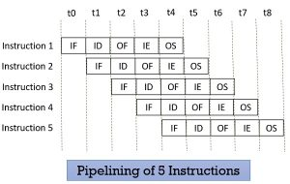
Pipelining Stages
Stages within a CPU pipelining process
At a very basic level, these stages can be broken down into:
fetch instructions from memory
read registers and decode the instruction
execute the instruction or calculate an address
access an operand in data memory
write the result into a register

Slide 17
Stages of instruction pipelining
Stage 1 ( IF- Instruction Fetch ) fetches instruction from memory In this stage the CPU reads instructions from the address in the memory whose value is present in the program counter.
Stage 2 (ID----Instruction Decode) decodes the instruction to be executed In this stage, instruction is decoded and the register file is accessed to get the values from the registers used in the instruction.
Stage 3 (IE--- Instruction Execute) execute the instruction In this stage, ALU operations are performed.
Stage 4 (Memory Access) In this stage, memory operands are read and written from/to the memory that is present in the instruction.
Stage 5 (IW Instruction Write) write the instruction back to memory or register In this stage, computed/fetched value is written back to the register present in the instructions.

Slide 18
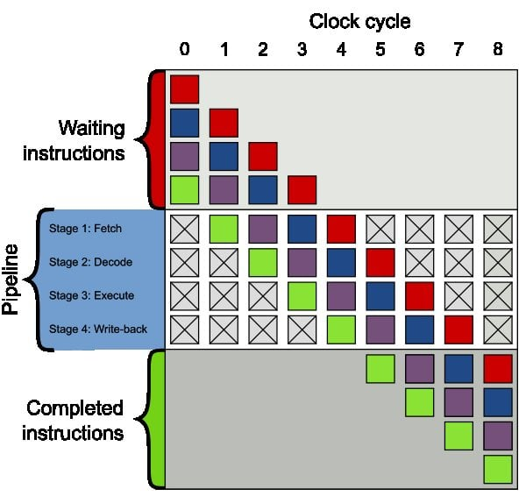
Stages of instruction pipelining

Slide 19
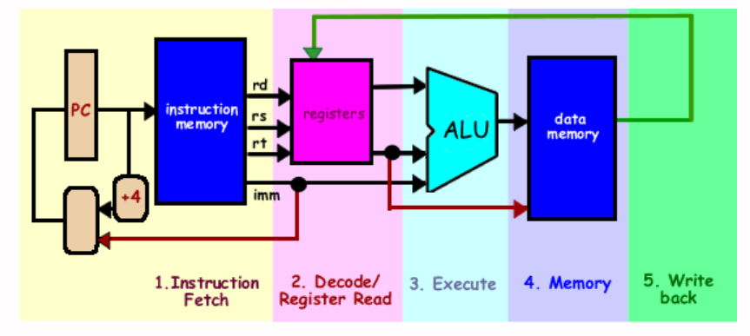
Pipeline registers
Pipelining attempts to keep every part of the processor busy with some instruction by dividing incoming instructions into a series of sequential steps performed by different processor units with different parts of instructions processed in parallel.
With CPU pipelining there is a need for access to registers between stages. They hold information produced in previous cycle

Slide 20
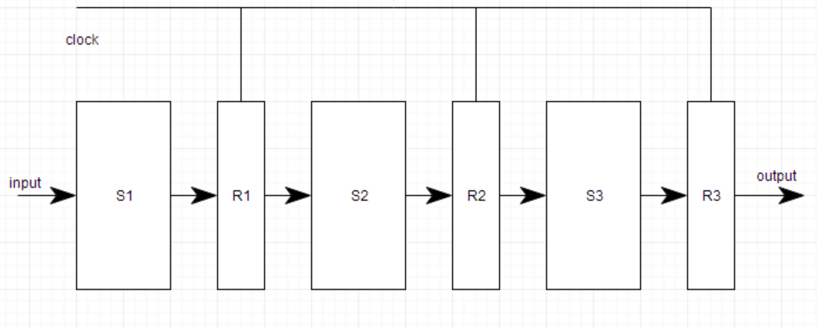
Pipeline registers
Each segment in the pipeline consists of an input register followed by a combinational circuit.
The register is used to hold data and combinational circuit performs operations on it.
The output of combinational circuit is applied to the input register of the next segment

Slide 21
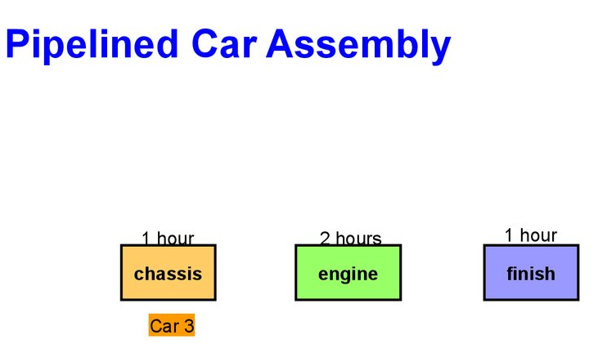
Pipeline cycle timing
The pipeline will be more efficient if the instruction cycle is divided into segments of equal duration.
The timing for each instruction needs to be calculated and then the maximum time needed for an instruction is known.
The worst-case scenario rule is used (Big O Notation) when we have different timings for instructions

Slide 22
Advantages of Pipelining
Instruction throughput increases.
Increase in the number of instructions executed simultaneously.
Faster ALU can be designed when pipelining is used.
Pipelined CPU’s works at higher clock frequencies than the RAM.
Pipelining increases the overall performance of the CPU

Slide 23
Disadvantages of Pipelining
Designing of the pipelined processor is complex and costly to manufacture.
Instruction latency increases in pipelined processors.
The throughput of a pipelined processor is difficult to predict.
The longer the pipeline, worse the problem of hazard for branch instructions.

